Slide 1
Philanthropy in Academia:
Chairs & desk Donation
Presented by:
The Osun Indigenes Organization ~ USA

Slide 2
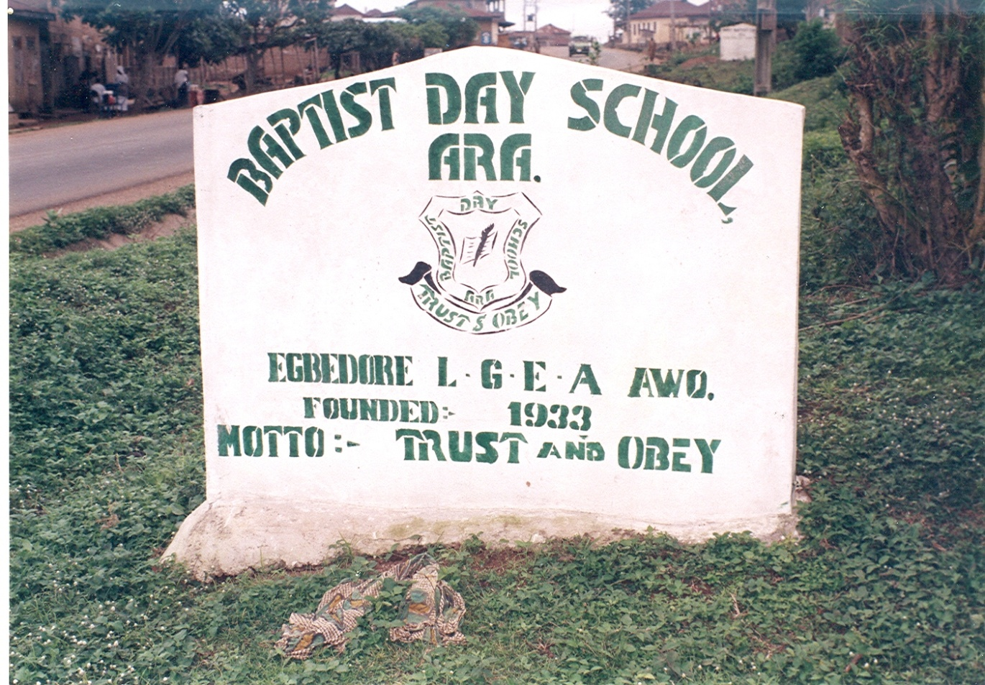
RECIPIENT OF DONATION

Slide 3
DILAPIDATED SCHOOL BUILDING ~ IREE

Slide 4
SAMPLE CHAIRS DONATED

Slide 5
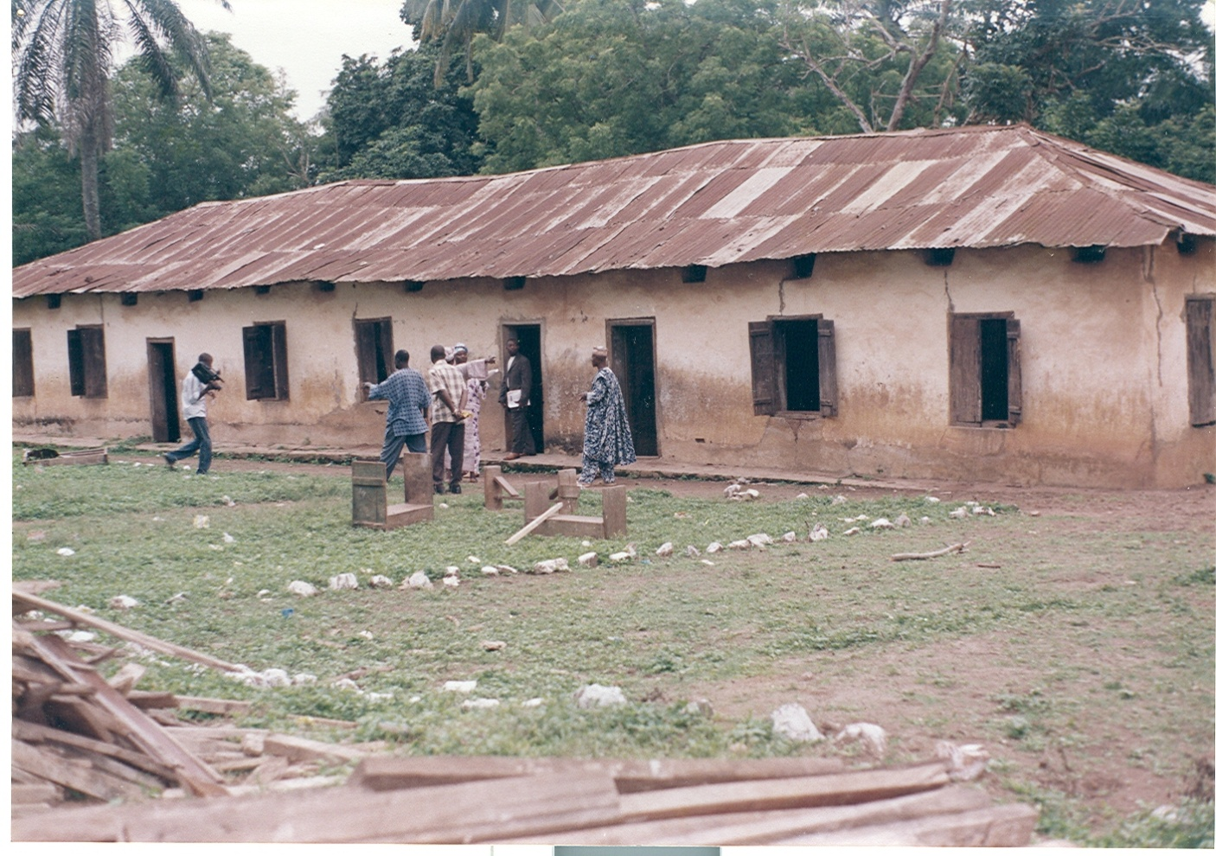
DILAPIDATED SCHOOL BUILDING ~ OKE ILA

Slide 6
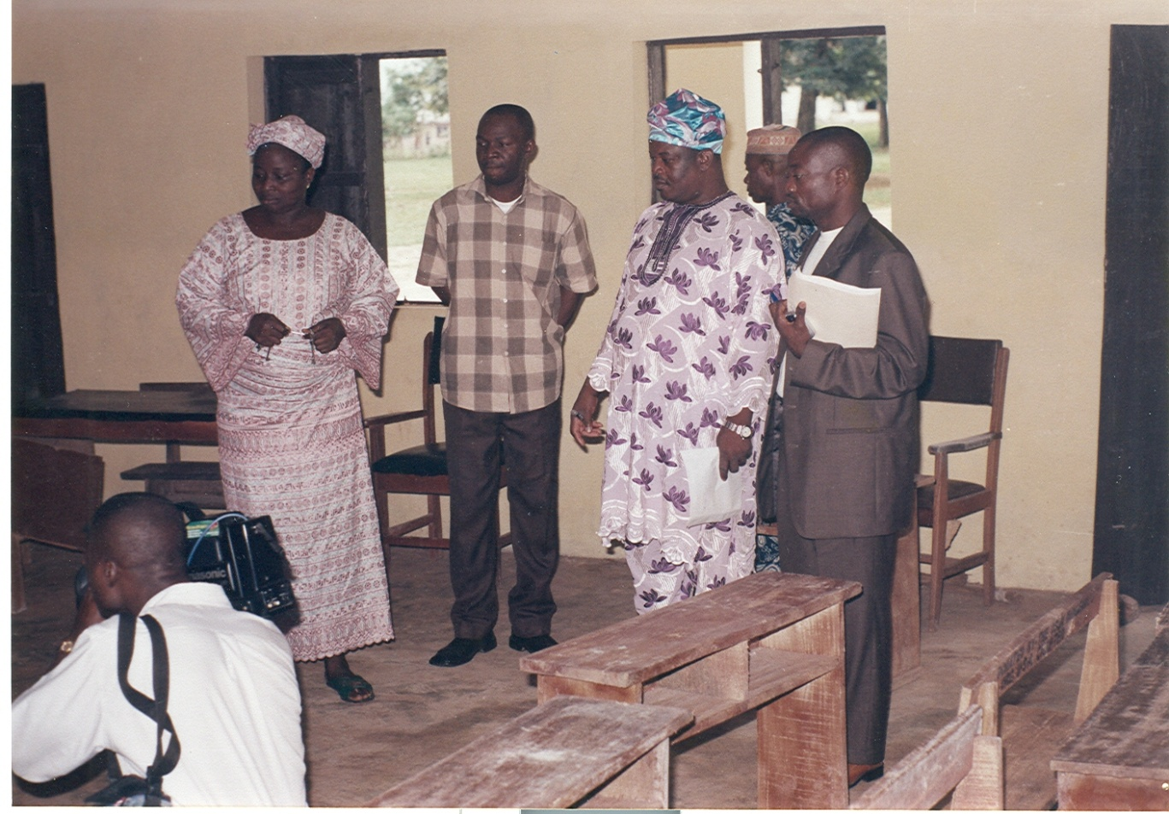
MEMBERS REVIEIWING DONATED PRODUCTS

Slide 7
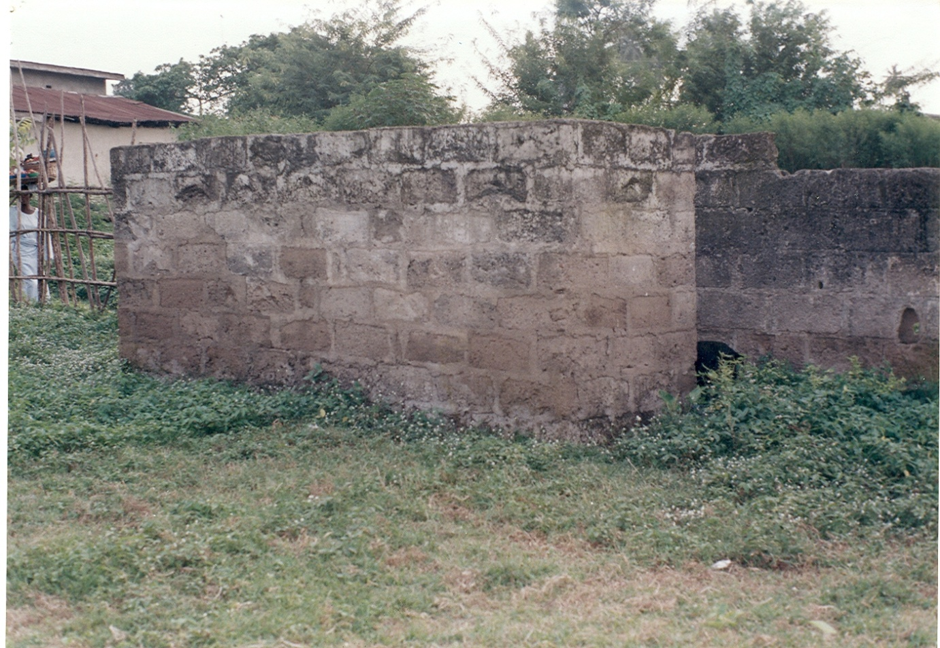
PRIMARY SCHOOL BUILDING ~ IGBAJO

Slide 8
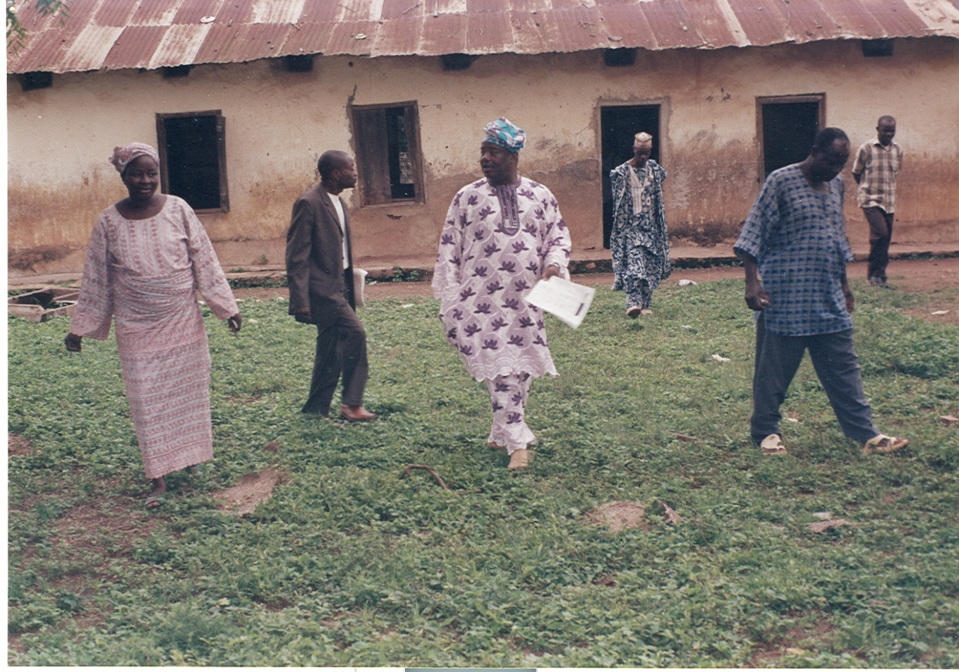

Slide 9
RECIPIENT OF PRODUCT

Slide 12
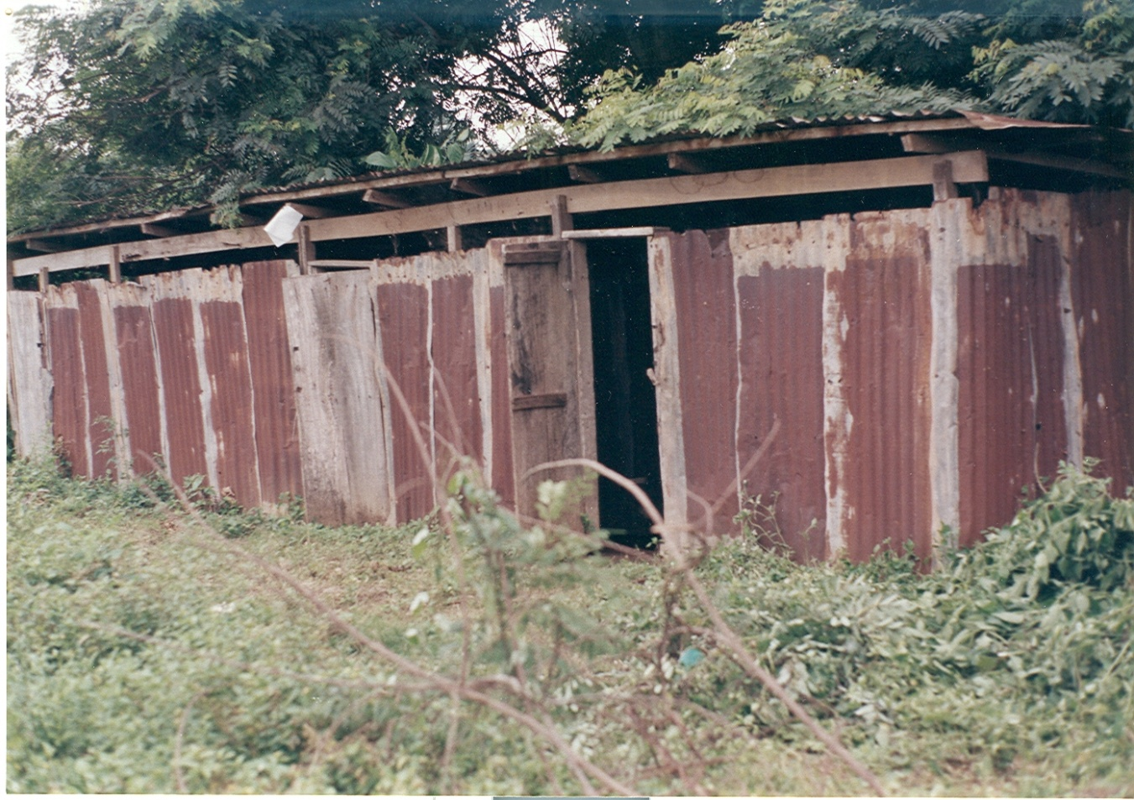
ABANDONED SCHOOL RESTROOM ~ IREE

Slide 13
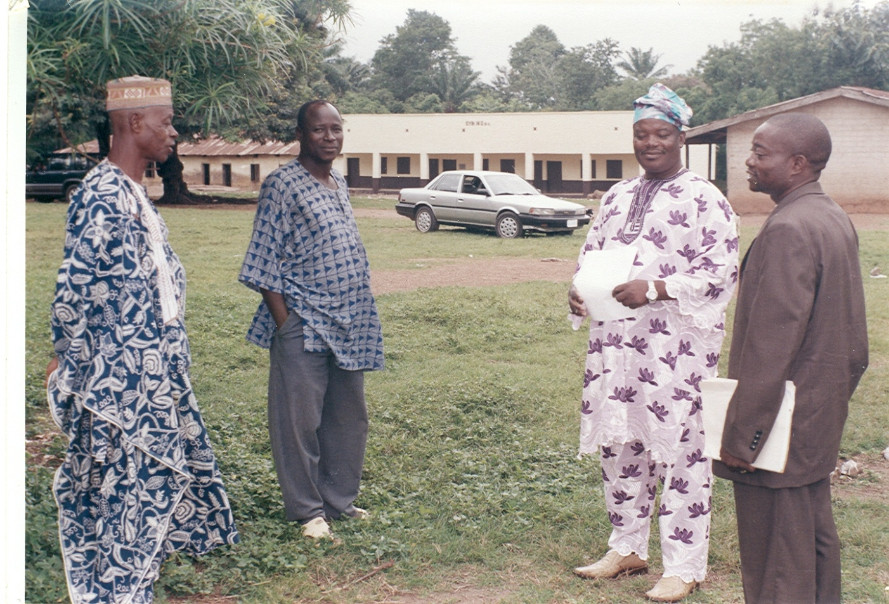

Slide 14
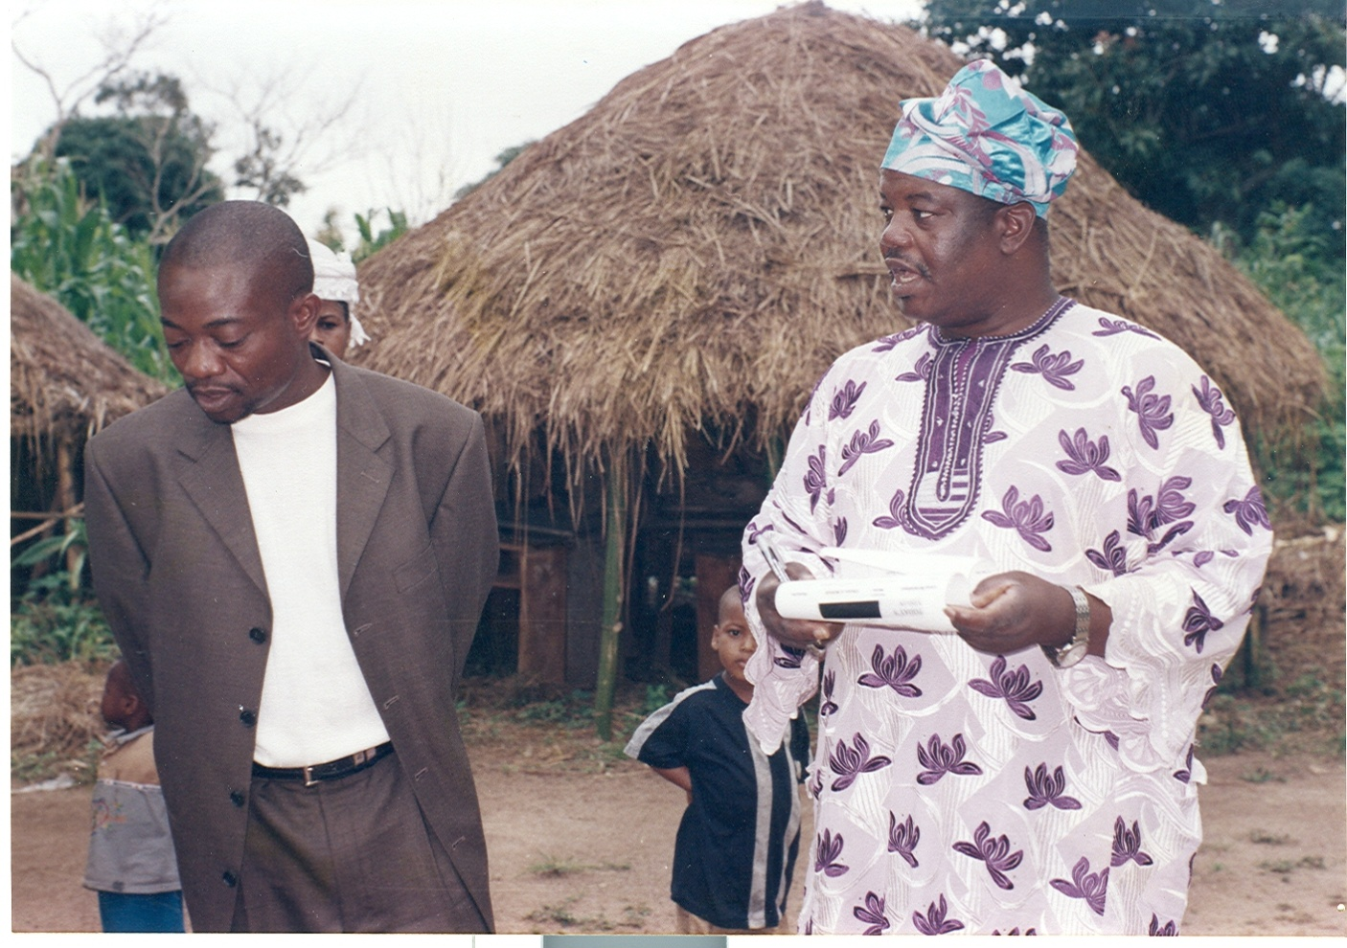
EJIGBO NOMAD SCHOOL
TOIOG CHAIRS/DESKS INSIDE SHED

Slide 16
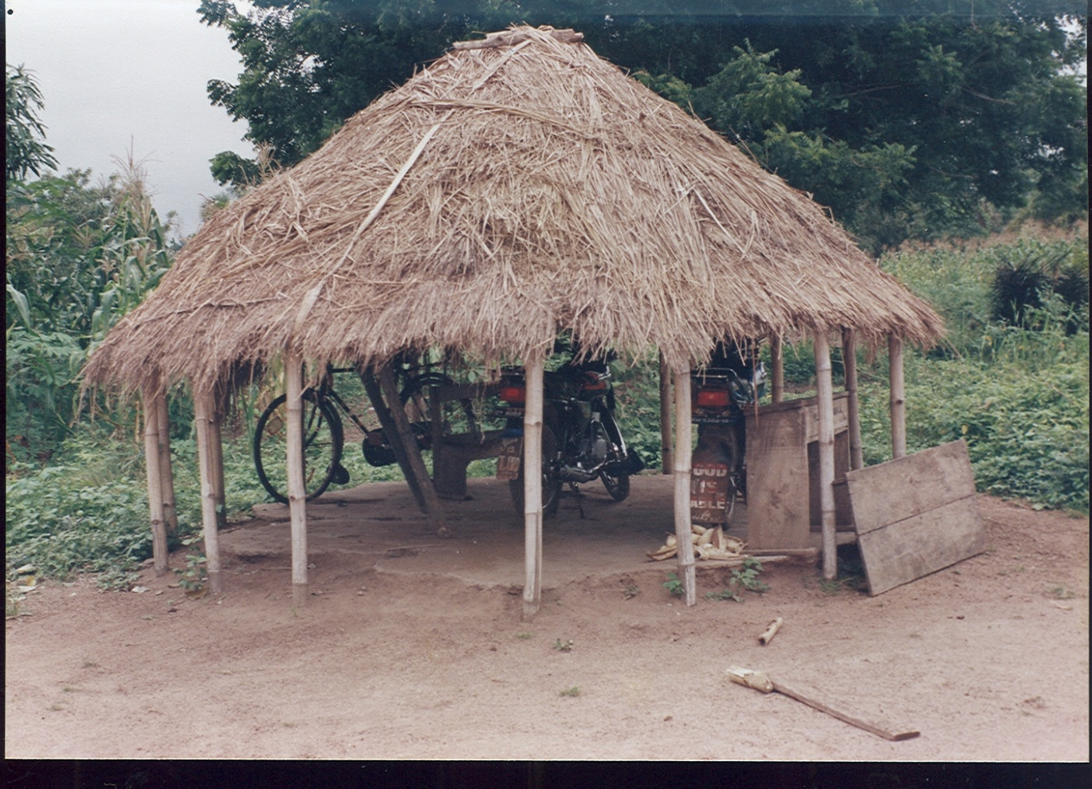
BICYCLE GARAGE ~ EJIGBO NOMAD SCHOOL

Slide 17
NEW CHAIRS DEPLOYMENT

Slide 18
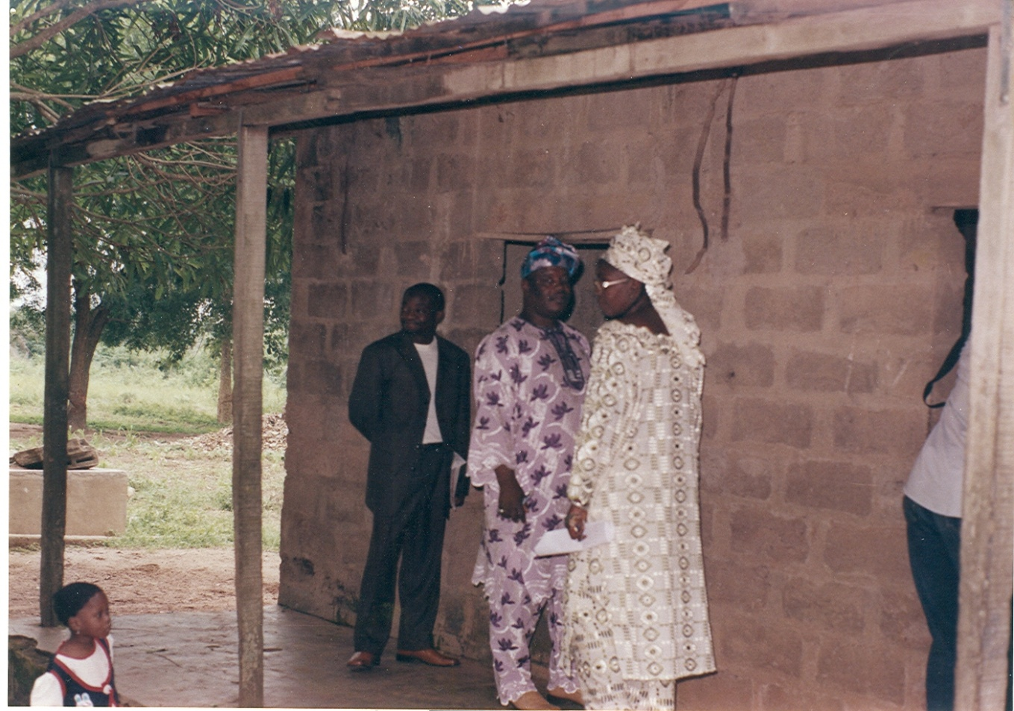

Slide 20
GBONGAN PRIMARY SCHOOL
Dilapidated Building

Slide 23
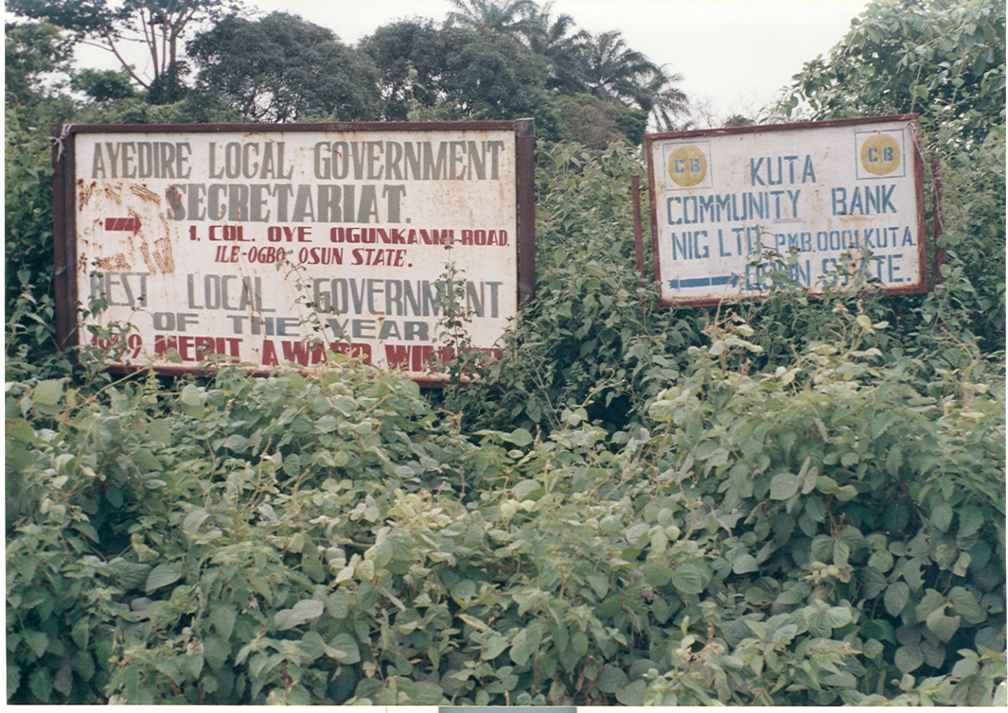

Slide 33
THANK YOU
PLEASE CONSIDER GIVING TO THE OSUN INDIGENES ORGANIZATION PROJECTS

